Slide 1


CS523 Final Project
Lien Thanh Le (Thanh)
Munkhdalai Nyamsuren (Munkh)
Pedro Salazar (Pedro)
Thanh Nam Nguyen (Nam)
TECHNOLOGY

Slide 2
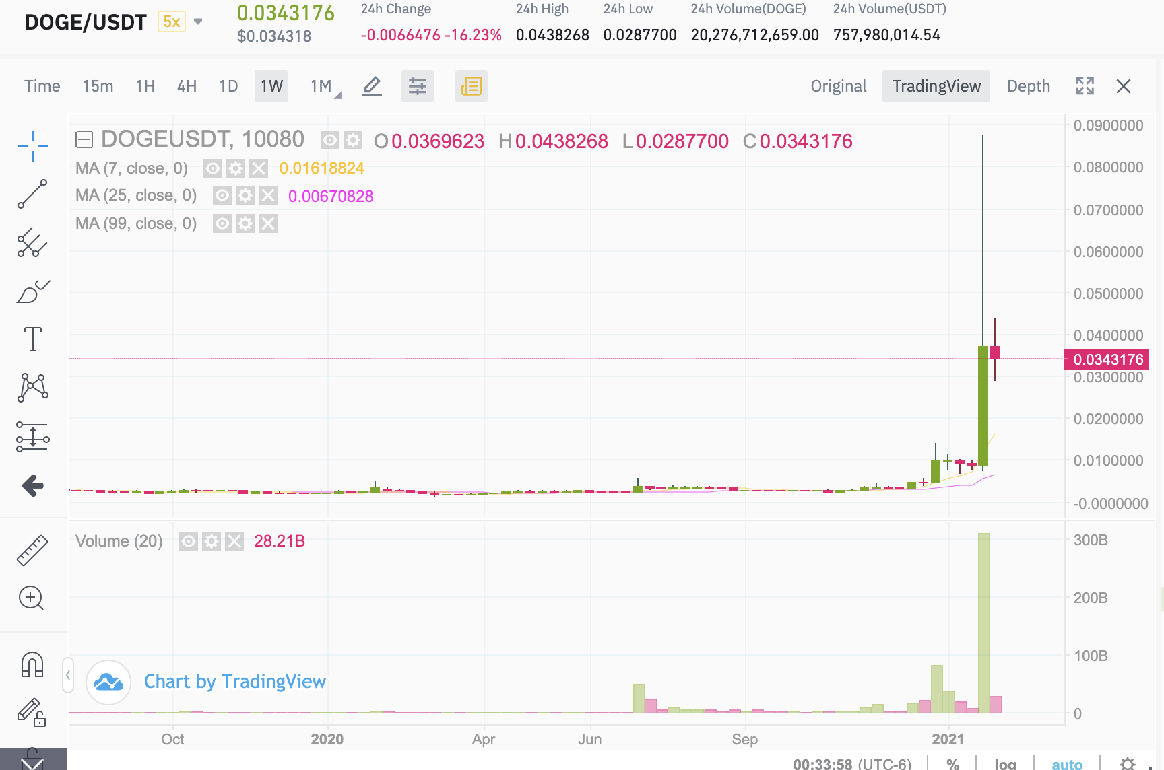


Problem
Statement
Need for analyzing trends on Twitter, for example, #DOGECOIN hashtag.
Need for a Big Data pipeline.
Gather Data -> Prepare Data -> Store Data
Analyze Data -> Discover Insights
Fast, Fault-tolerant System.

Slide 3
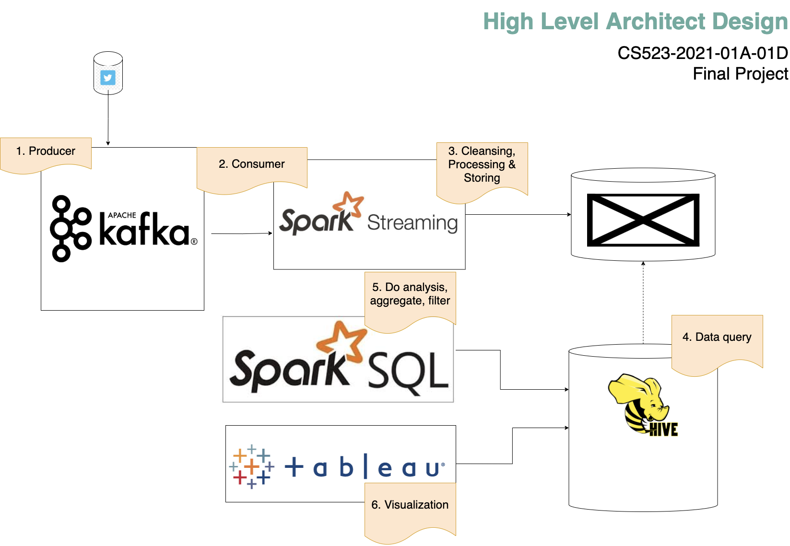

High Level Architecture Diagram

Slide 4


Data Extraction Twitter API & Kafka Producer
Get Twitter keys and tokens
Read tweets and send to topics

Slide 5

Data Transformation Kafka Consumer & Spark Streaming
Create Streaming Context
Set Kafka Parameters
Prepare Data

Slide 6

Data Load Spark Streaming & HDFS
Save Data in HDFS
Use Hive for data manipulation

Slide 7

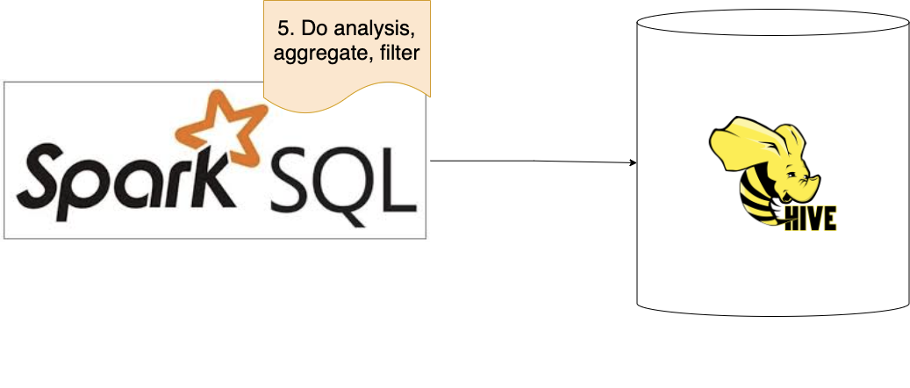
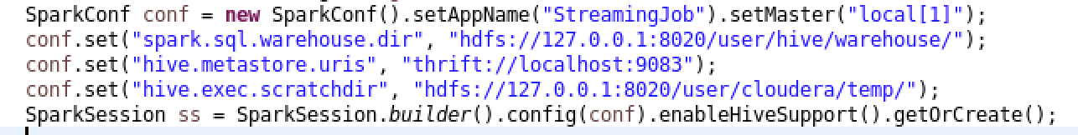
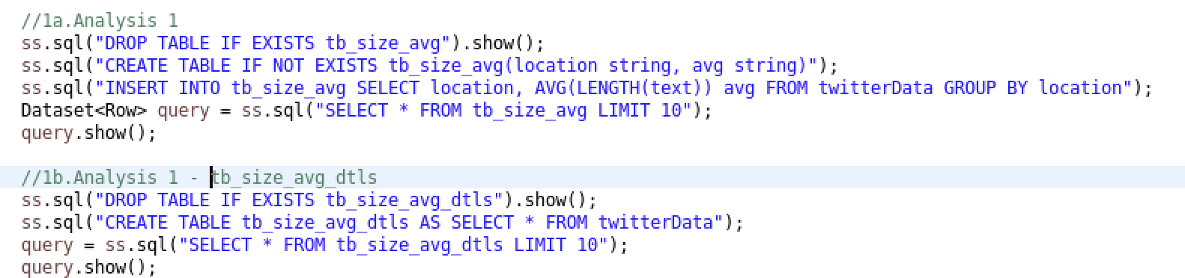
Spark SQL & Hive
SparkSession makes it ready to work on Hive
Depend on needs:
- Preparing data with SQL
- Aggregate data with SQL
- Processing with SQL

Slide 8


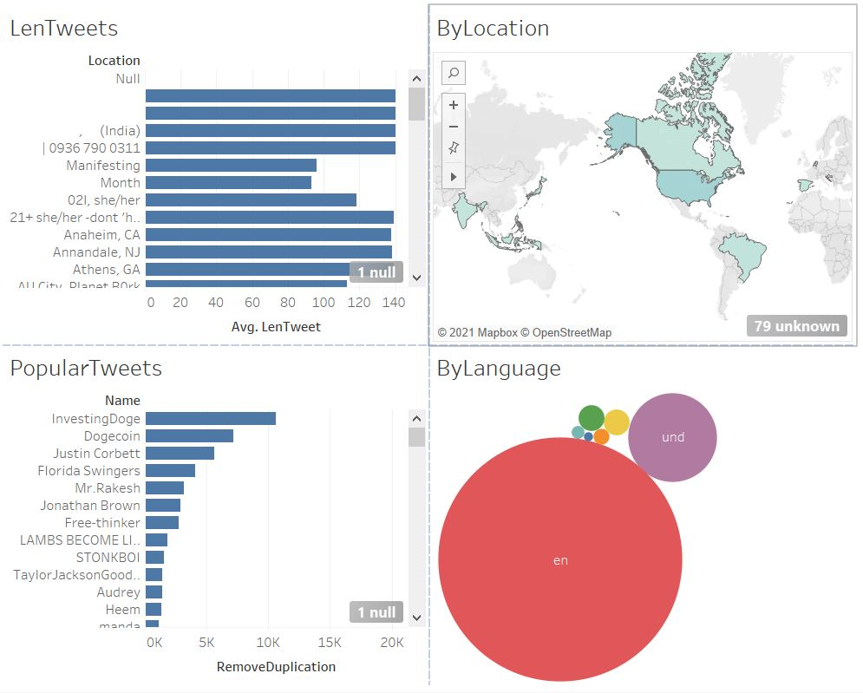
Hive & Tableau Analysis
Connecting to Hadoop/Hive using Schemas
Analysis on the Tableau

Slide 9

Project Demo

Slide 10

THANK YOU! Q&A

